Slide 1
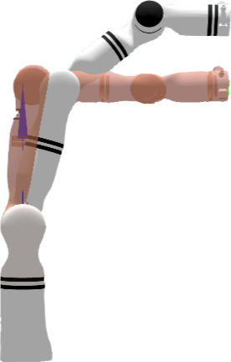
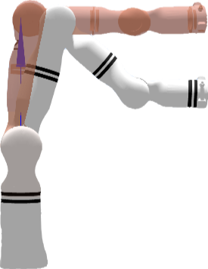
Z+
Z-

Slide 2
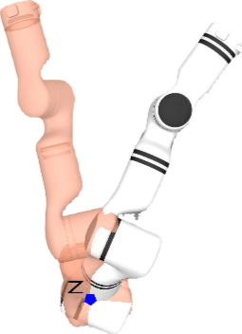
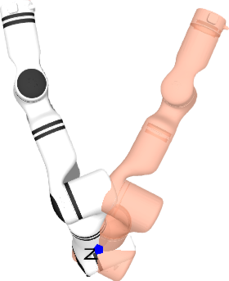
Y+
Y-

Slide 3
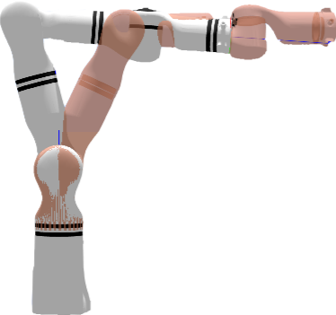
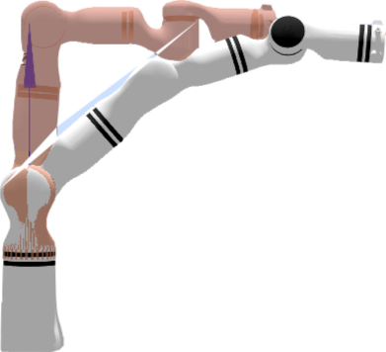
X+
X-
X+
Y+
Y-
Z+
Z-

Slide 5
start
stop
connect
Flexible
Intelligent
Lab
X+
Y+
Z+
X-
Y-
Z-
+90°
-90°
grab

Slide 6
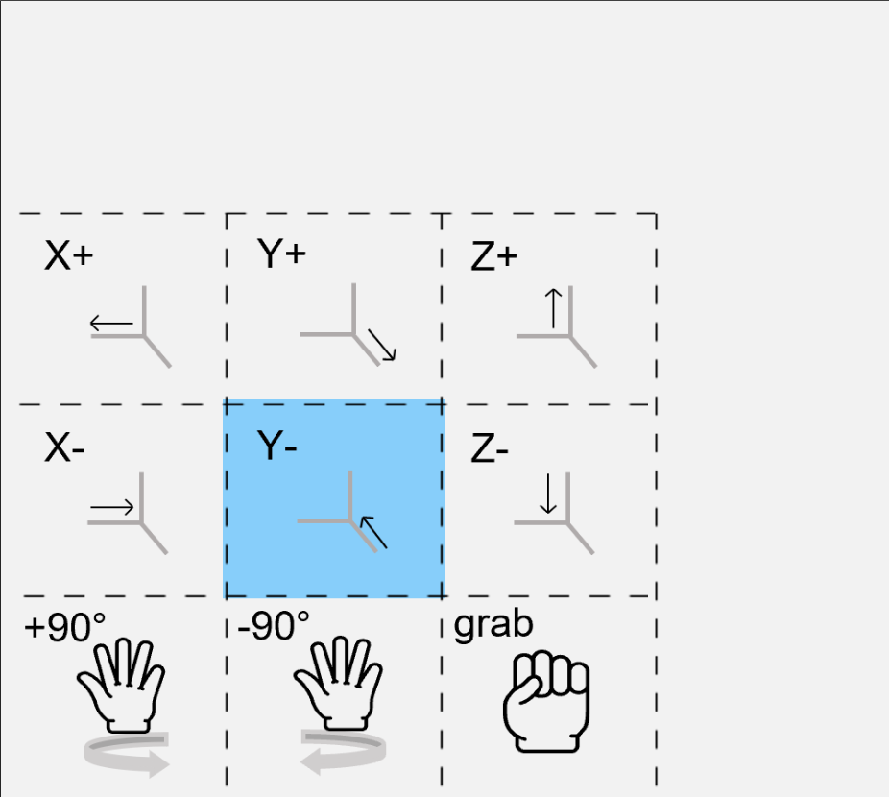
Flexible Intelligent Lab
X+
Y+
Z+
X-
Y-
Z-
+90°
-90°
grab

Slide 7
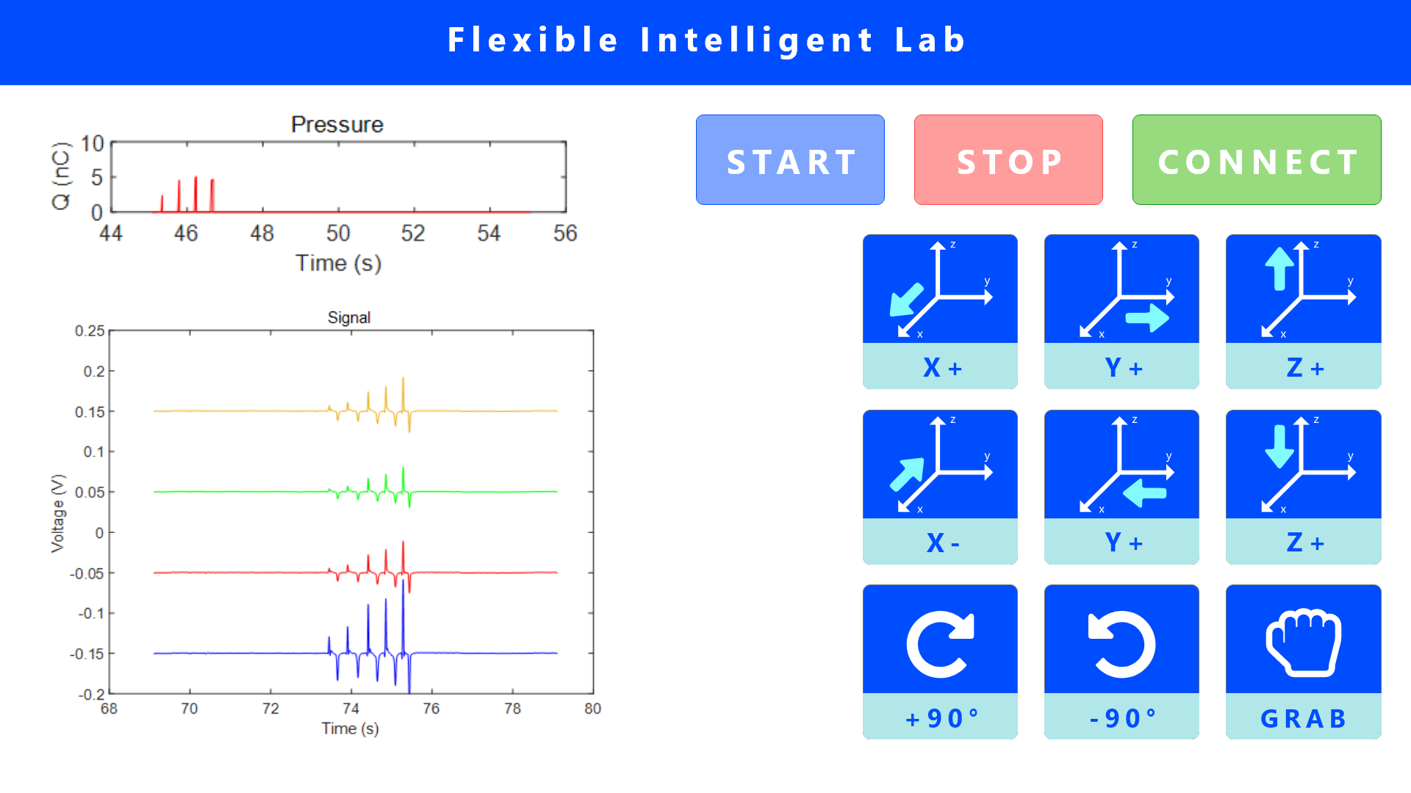
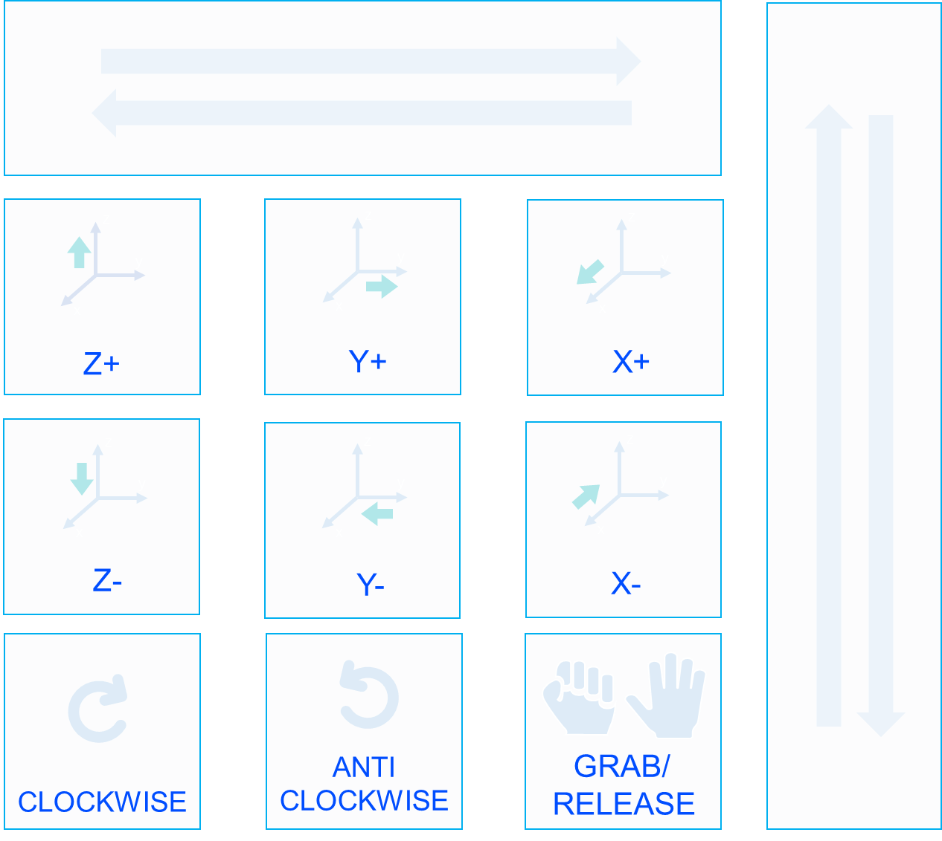
(1)
RELEASE
z
z
z
y
y
y
x
x
x
Z+
Y+
X+
z
z
z
y
y
y
x
x
x
Z-
Y-
X-
ANTI
CLOCKWISE
GRAB/
CLOCKWISE
RELEASE

Slide 8

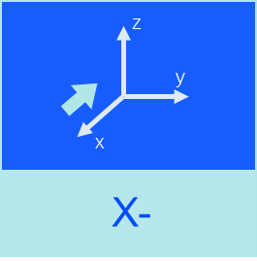
(12)
z
z
y
y
x
x
Z+
Z-
z
y
x
z
X+
y
Move down
x
Y+
z
y
x
z
RELEASE
Y-
y
x
X-
GRAB
ANTI
CLOCKWISE
CLOCKWISE

Slide 9
Move Right
Move up
Move down
Move Left

Slide 10
X
Y
Z

